Slide 1
Autopilot
Team (4)

Slide 2
Team members
name | sec | bn
Mohammed Ahmed Hassan Ahmed | 2 | 37
Ibrahim Thabet Allam | 1 | 1
Mohammed Hatem Mohammed Saeed | 2 | 39
Mohamed Hassan Gad Ali | 2 | 41
Mohammed Abd El Mawgoud Ghoneam | 2 | 43

Slide 3
Autopilot literature review
Task 1

Slide 4
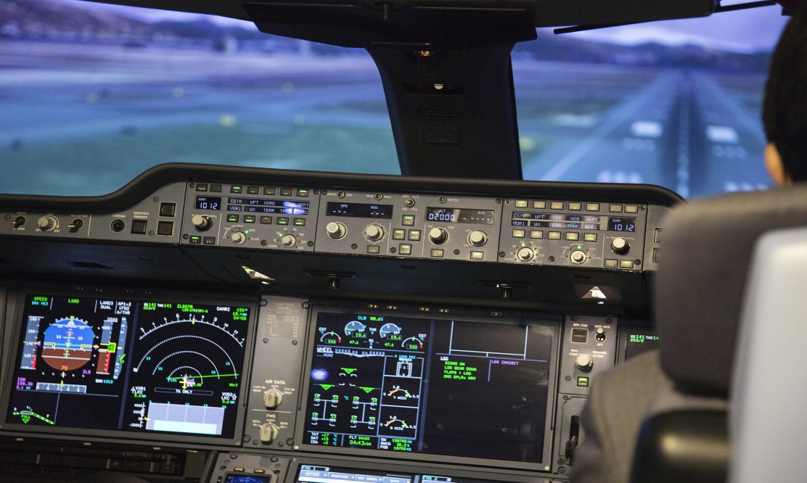
Research questions
Autopilot
An autopilot is a system that allows an airplane to navigate without the need for constant manual control by a human operator

Slide 5
Inputs and outputs of Autopilot system
inputs
Control Inputs:
Radio Control Receivers
MAVLink Data Streams, ie ground control stations or companion computers
Sensor inputs:
GPS, Compass, Airspeed, Rangefinders, IMU
Power Management Unit Inputs:
Received Signal Strength Input (RSSI)
Analog Airspeed Sensors

Slide 6
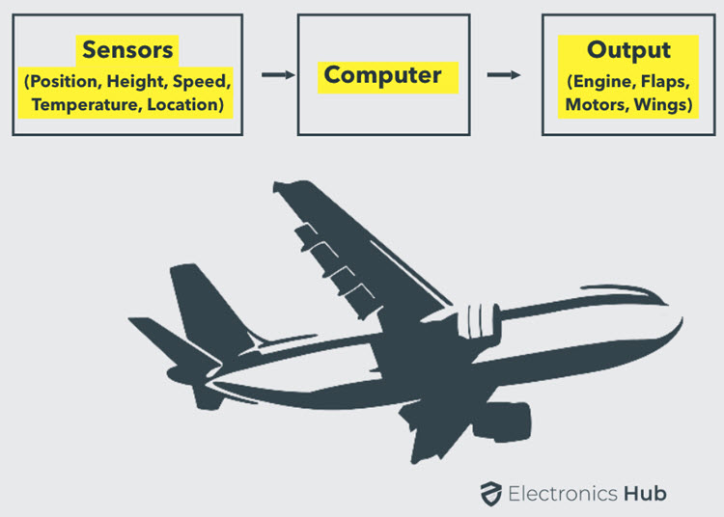
Inputs and outputs of Autopilot system
Outputs
ESCs (electronic circuit that controls and regulates the speed of an electric motor) for motors
Servos for control surfaces
Telemetry data
Actuators and General Purpose I/O like LEDs, buzzers etc

Slide 7
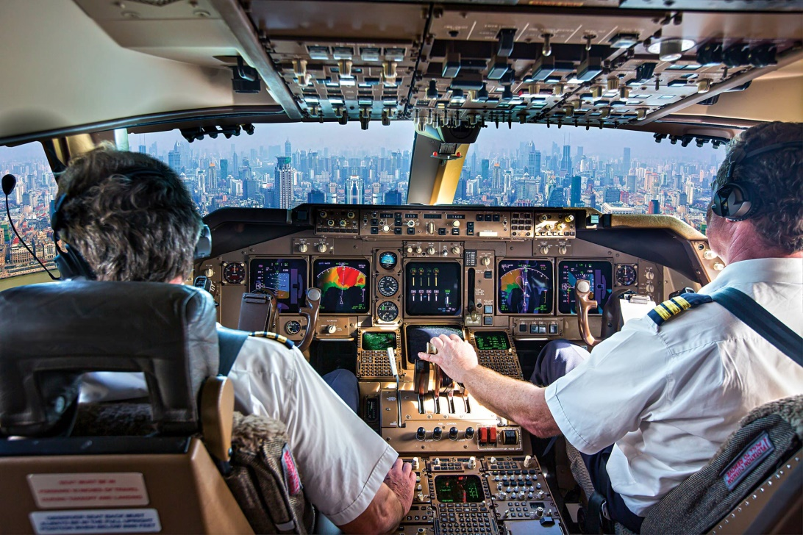
the role of the pilot in an airplane equipped with an autopilot
The pilot sets the flight plan and turn on the autopilot sometimes the pilot reprograms the autopilot in case if worked incorrectly. autopilot is not smart enough to fly a plane by It self

Slide 8
What is the difference between Autopilot & SAS?
SAS (Stability augmentation system) generally used during low and slow maneuvering where the pilot may be making constant attitude changes in preparation for landing.
Autopilot do same functions as SAS in addition it provides more functions ,Autopilot Is more sophisticated than SAS

Slide 9
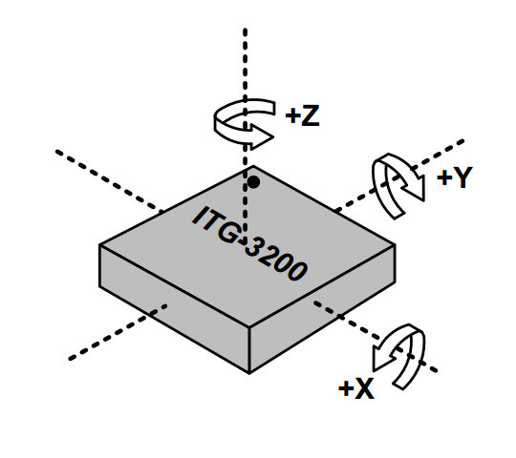
Role of onboard sensors
Sensors provide the autopilot computers with data like speed, coordinates, position so the computers can estimate the states and give the correct control actions to the actuators for example
Gyroscope an IMU supplies the autopilot with position data so if the airplane in incorrect position it gives the actuator signal so that it can adjust position

Slide 10
Flight Mechanics review
Assume
The body is rigid which means the mass is constant and there is no change in geometry (Stress calculations are neglected).
Fix a body axes at the center of mass of the rigid body.

Slide 11
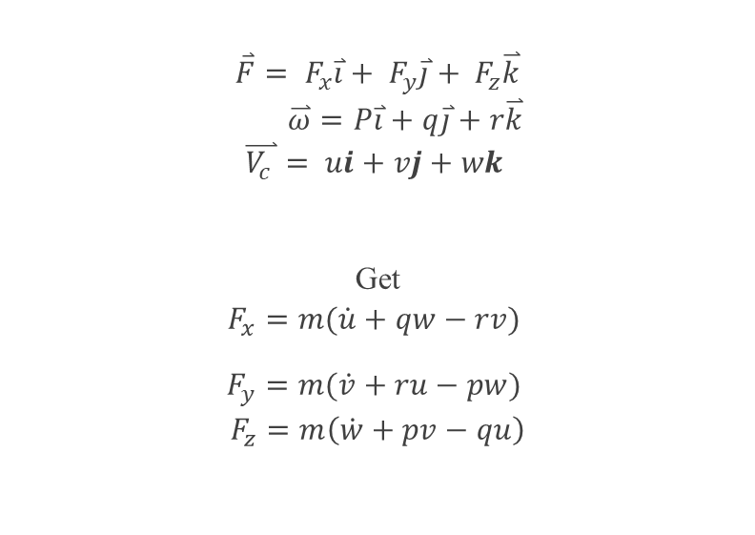
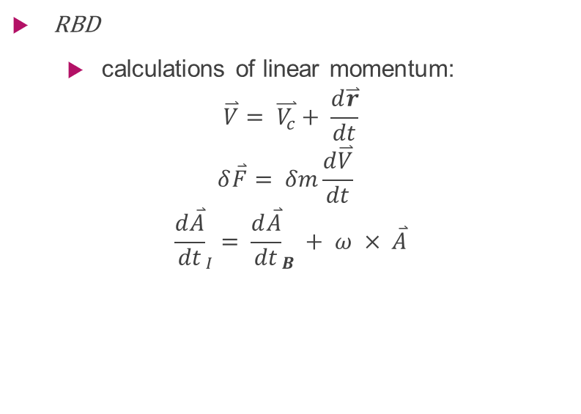
Flight Mechanics review
RBD
calculations of linear momentum:
$$\overset{⃑}{V}= \overset{⃑}{V_{c}}+ \frac{d\overset{⃑}{r}}{dt}$$
$$δ\overset{⃑}{F}= δm\frac{d\overset{⃑}{V}}{dt}$$
$${\frac{d\overset{⃑}{A}}{dt}}_{I}= {\frac{d\overset{⃑}{A}}{dt}}_{B }+ ω × \overset{⃑}{A}$$
$$\overset{⃑}{F}= F_{x}\overset{⃑}{i}+ F_{y}\overset{⃑}{j}+ F_{z}\overset{⃑}{k}$$
$$\overset{⃑}{ω}=P\overset{⃑}{i}+q\overset{⃑}{j}+r\overset{⃑}{k}$$
$$\overset{⃑}{V_{c }}= ui+vj+wk$$
Get
$$F_{x}=m(\dot{u}+qw−rv)$$
$$F_{y}=m(\dot{v}+ru−pw)$$
$$F_{z}=m\left(\dot{w}+pv−qu\right)$$

Slide 12
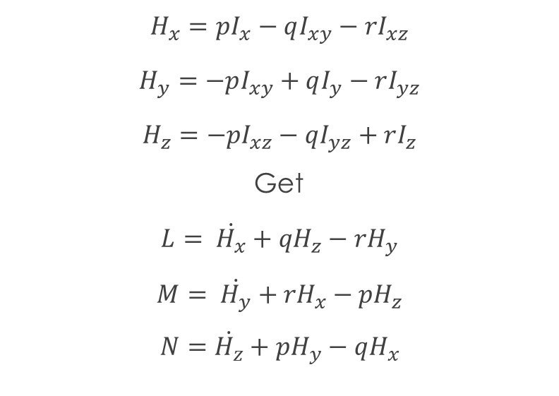
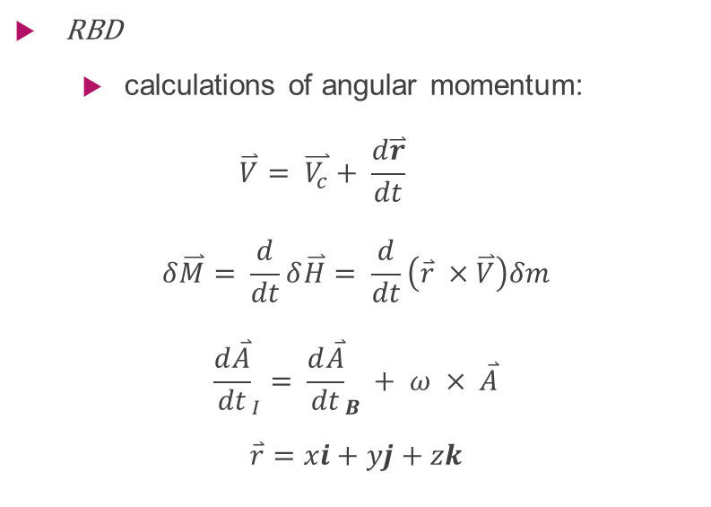
Flight Mechanics review
RBD
calculations of angular momentum:
$$\overset{⃑}{V}= \overset{⃑}{V_{c}}+ \frac{d\overset{⃑}{r}}{dt}$$
$$δ\overset{⃑}{M}= \frac{d}{dt}δ\overset{⃑}{H}= \frac{d}{dt}\left(\overset{⃑}{r} ×\overset{⃑}{V}\right)δm$$
$${\frac{d\overset{⃑}{A}}{dt}}_{I}= {\frac{d\overset{⃑}{A}}{dt}}_{B }+ ω × \overset{⃑}{A}$$
$$\overset{⃑}{r}=xi+yj+zk$$
$$H_{x}=pI_{x}−qI_{xy}−rI_{xz}$$
$$H_{y}=−pI_{xy}+qI_{y}−rI_{yz}$$
$$H_{z}=−pI_{xz}−qI_{yz}+rI_{z}$$
Get
$$L= \dot{H_{x}}+{qH}_{z}−rH_{y}$$
$$M= \dot{H_{y}}+{rH}_{x}−pH_{z}$$
$$N=\dot{H_{z}}+pH_{y}−qH_{x}$$

Slide 13
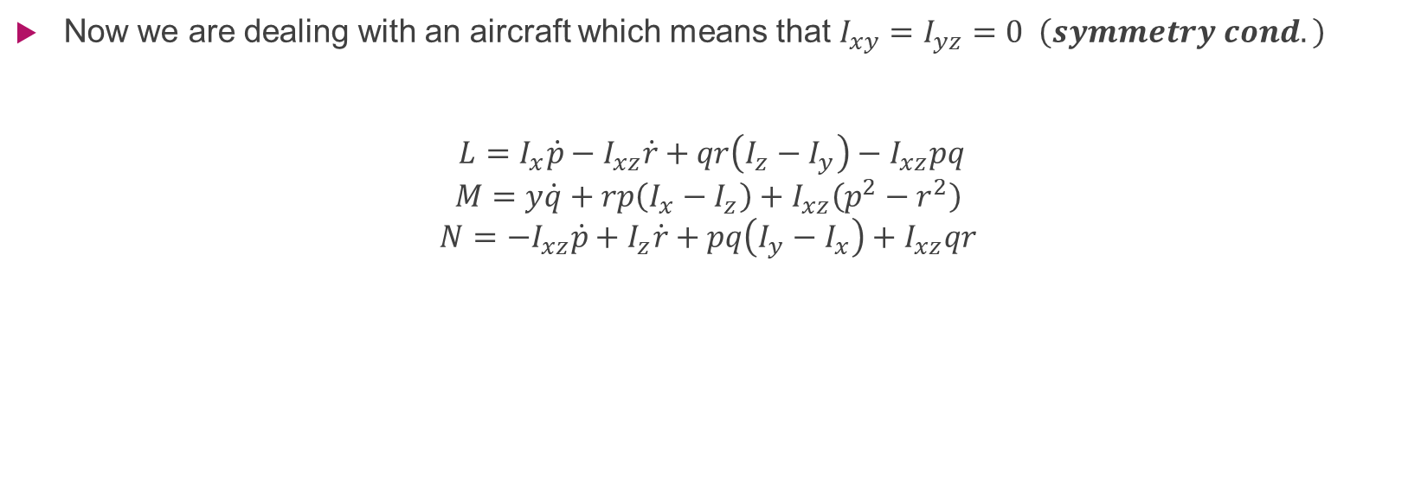
Flight Mechanics review
Now we are dealing with an aircraft which means that $I_{xy}=I_{yz}=0 \left(symmetry cond.\right)$
$$L=I_{x}\dot{p}−I_{xz}\dot{r}+qr\left(I_{z}−I_{y}\right)−I_{xz}pq$$
$$M=y\dot{q}+rp\left(I_{x}−I_{z}\right)+I_{xz}\left(p^{2}−r^{2}\right)$$
$$N={−I}_{xz}\dot{p}+I_{z}\dot{r}+pq\left(I_{y}−I_{x}\right)+I_{xz}qr$$

Slide 14
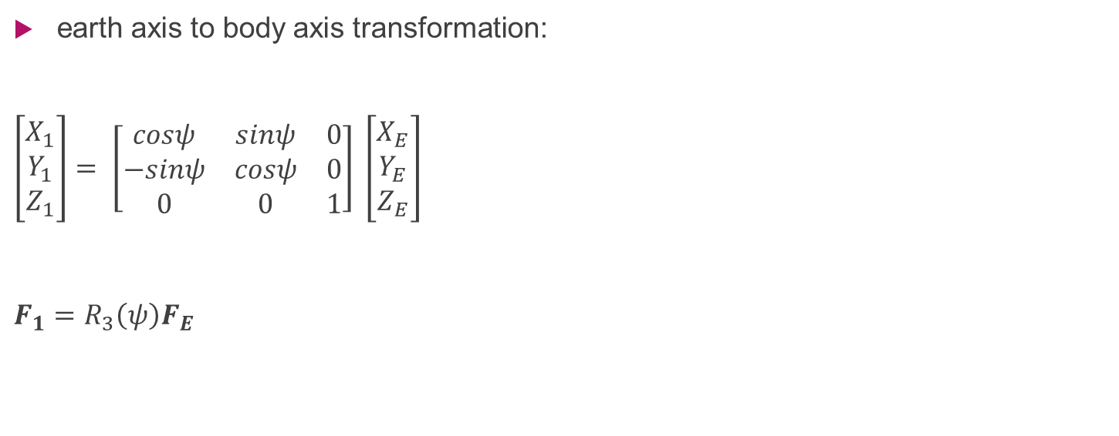
Flight Mechanics review
earth axis to body axis transformation:
$\left[\begin{aligned}X_{1} \\ Y_{1} \\ Z_{1}\end{aligned}\right]= \left[\begin{matrix}cosψ & sinψ & 0 \\ −sinψ & cosψ & 0 \\ 0 & 0 & 1\end{matrix}\right] \left[\begin{aligned}X_{E} \\ Y_{E} \\ Z_{E}\end{aligned}\right]$
$$F_{1}=R_{3}\left(ψ\right)F_{E}$$

Slide 15
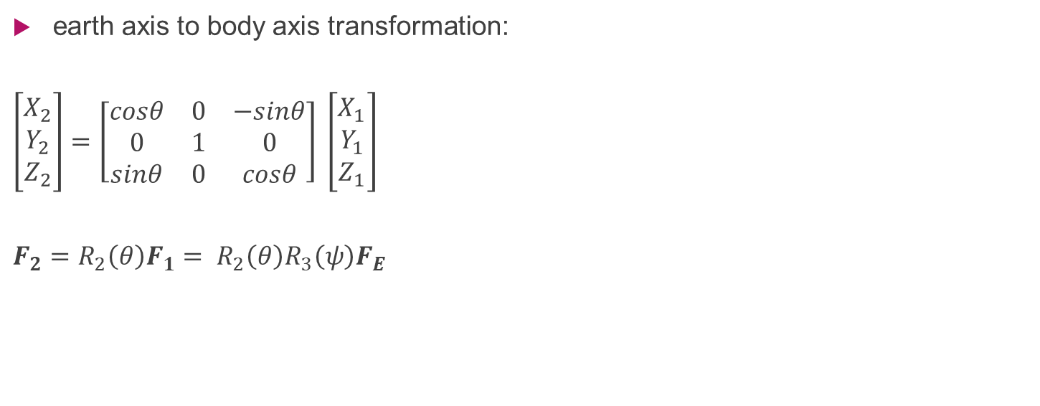
Flight Mechanics review
earth axis to body axis transformation:
$$\left[\begin{aligned}X_{2} \\ Y_{2} \\ Z_{2}\end{aligned}\right]=\left[\begin{matrix}cosθ & 0 & −sinθ \\ 0 & 1 & 0 \\ sinθ & 0 & cosθ\end{matrix}\right] \left[\begin{aligned}X_{1} \\ Y_{1} \\ Z_{1}\end{aligned}\right]$$
$$F_{2}=R_{2}\left(θ\right)F_{1}= R_{2}\left(θ\right)R_{3}\left(ψ\right)F_{E}$$

Slide 16
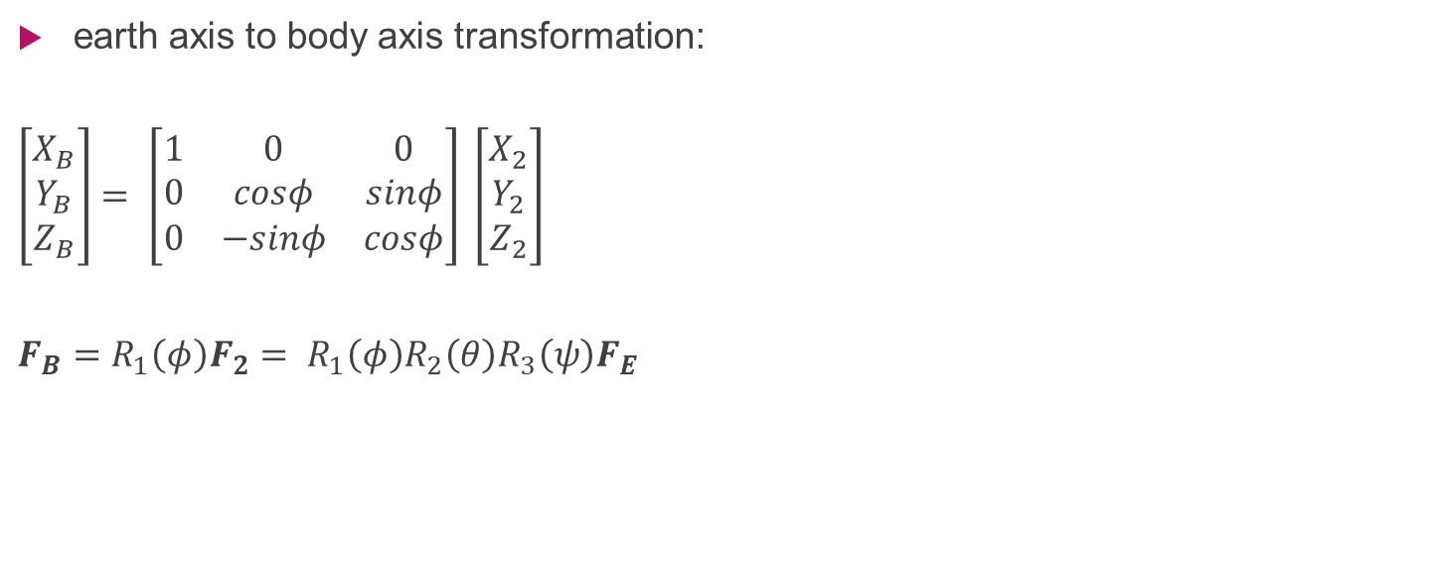
Flight Mechanics review
earth axis to body axis transformation:
$$\left[\begin{aligned}X_{B} \\ Y_{B} \\ Z_{B}\end{aligned}\right]= \left[\begin{matrix}1 & 0 & 0 \\ 0 & cosφ & sinφ \\ 0 & −sinφ & cosφ\end{matrix}\right] \left[\begin{aligned}X_{2} \\ Y_{2} \\ Z_{2}\end{aligned}\right]$$
$$F_{B}=R_{1}\left(φ\right)F_{2}= R_{1}\left(φ\right)R_{2}\left(θ\right)R_{3}\left(ψ\right)F_{E}$$

Slide 17
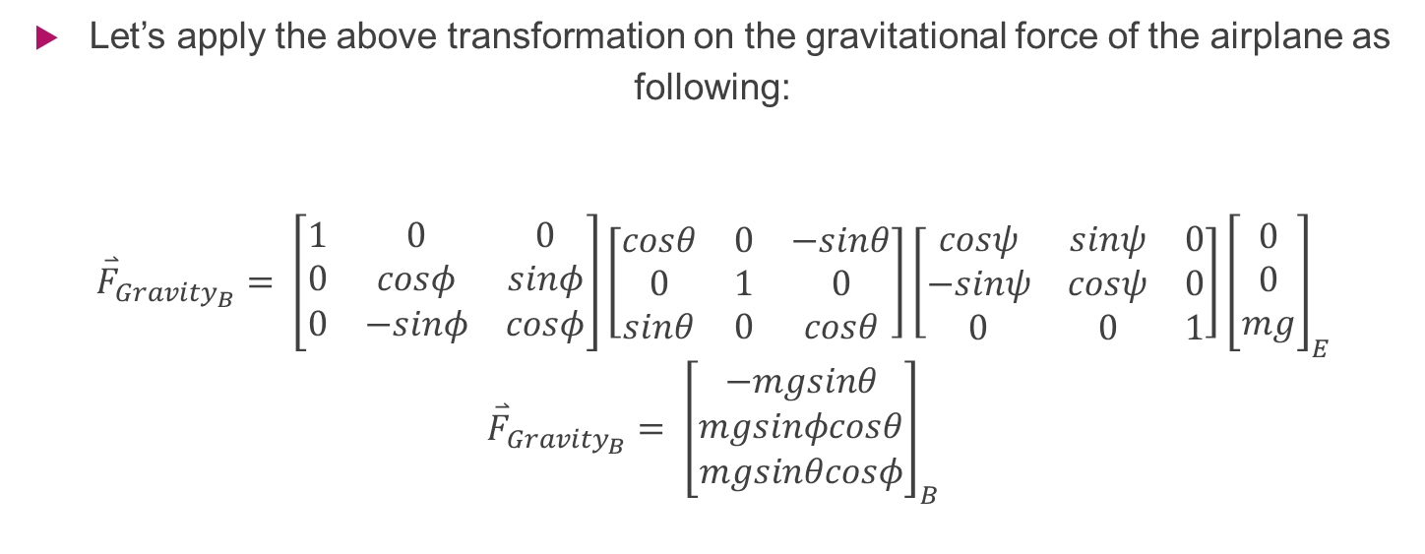
Flight Mechanics review
Let’s apply the above transformation on the gravitational force of the airplane as following:
$${\overset{⃑}{F}}_{{Gravity}_{B}}= \left[\begin{matrix}1 & 0 & 0 \\ 0 & cosφ & sinφ \\ 0 & −sinφ & cosφ\end{matrix}\right]\left[\begin{matrix}cosθ & 0 & −sinθ \\ 0 & 1 & 0 \\ sinθ & 0 & cosθ\end{matrix}\right]\left[\begin{matrix}cosψ & sinψ & 0 \\ −sinψ & cosψ & 0 \\ 0 & 0 & 1\end{matrix}\right]{\left[\begin{aligned}0 \\ 0 \\ mg\end{aligned}\right]}_{E}$$
$${\overset{⃑}{F}}_{{Gravity}_{B}}= {\left[\begin{aligned}−mgsinθ \\ mgsinφcosθ \\ mgsinθcosφ\end{aligned}\right]}_{B}$$

Slide 18
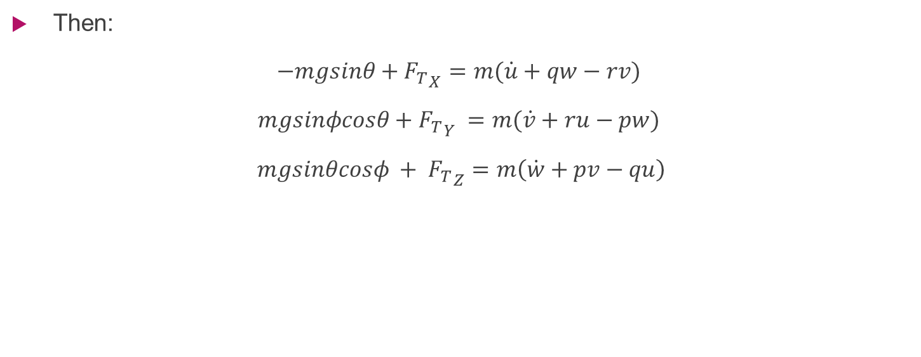
Flight Mechanics review
Then:
$$−mgsinθ+{F_{T}}_{X}=m(\dot{u}+qw−rv)$$
$$mgsinφcosθ+{F_{T}}_{Y} =m(\dot{v}+ru−pw)$$
$$mgsinθcosφ + {F_{T}}_{Z}=m\left(\dot{w}+pv−qu\right)$$

Slide 19
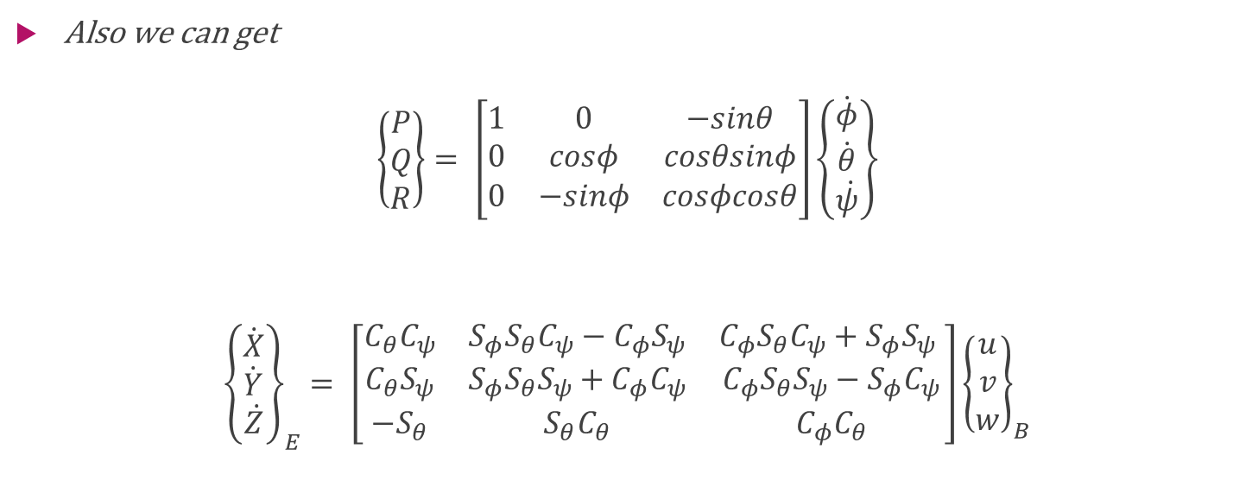
Flight Mechanics review
Also we can get
$$\left\{\begin{aligned}P \\ Q \\ R\end{aligned}\right\}= \left[\begin{matrix}1 & 0 & −sinθ \\ 0 & cosφ & cosθsinφ \\ 0 & −sinφ & cosφcosθ\end{matrix}\right]\left\{\dot{\begin{aligned}φ \\ \dot{\begin{aligned}θ \\ \dot{ψ}\end{aligned}}\end{aligned}}\right\}$$
$${\left\{\dot{\begin{aligned}X \\ \dot{\begin{aligned}Y \\ \dot{Z}\end{aligned}}\end{aligned}}\right\}}_{E}= \left[\begin{matrix}C_{θ}C_{ψ} & S_{φ}S_{θ}C_{ψ}−C_{φ}S_{ψ} & C_{φ}S_{θ}C_{ψ}+S_{φ}S_{ψ} \\ C_{θ}S_{ψ} & S_{φ}S_{θ}S_{ψ}+C_{φ}C_{ψ} & C_{φ}S_{θ}S_{ψ}−S_{φ}C_{ψ} \\ −S_{θ} & S_{θ}C_{θ} & C_{φ}C_{θ}\end{matrix}\right]{\left\{\begin{aligned}u \\ v \\ w\end{aligned}\right\}}_{B}$$

Slide 20
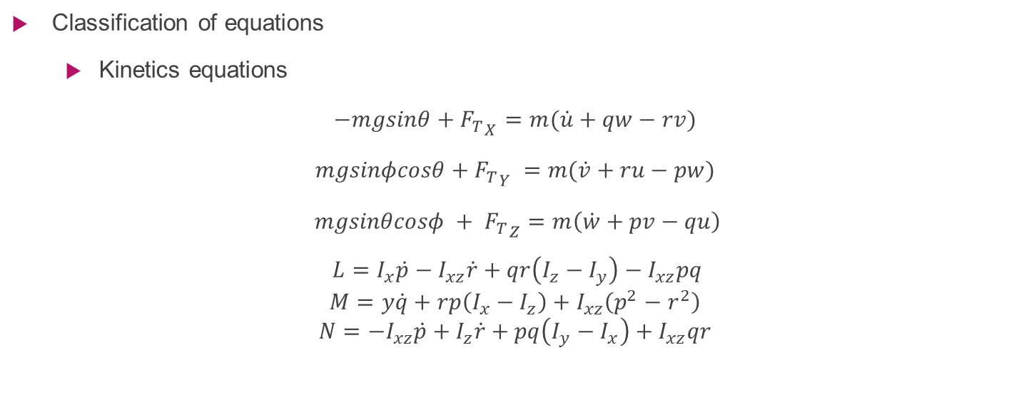
Flight Mechanics review
Classification of equations
Kinetics equations
$$−mgsinθ+{F_{T}}_{X}=m(\dot{u}+qw−rv)$$
$$mgsinφcosθ+{F_{T}}_{Y} =m(\dot{v}+ru−pw)$$
$$mgsinθcosφ + {F_{T}}_{Z}=m\left(\dot{w}+pv−qu\right)$$
$$L=I_{x}\dot{p}−I_{xz}\dot{r}+qr\left(I_{z}−I_{y}\right)−I_{xz}pq$$
$$M=y\dot{q}+rp\left(I_{x}−I_{z}\right)+I_{xz}\left(p^{2}−r^{2}\right)$$
$$N={−I}_{xz}\dot{p}+I_{z}\dot{r}+pq\left(I_{y}−I_{x}\right)+I_{xz}qr$$

Slide 21
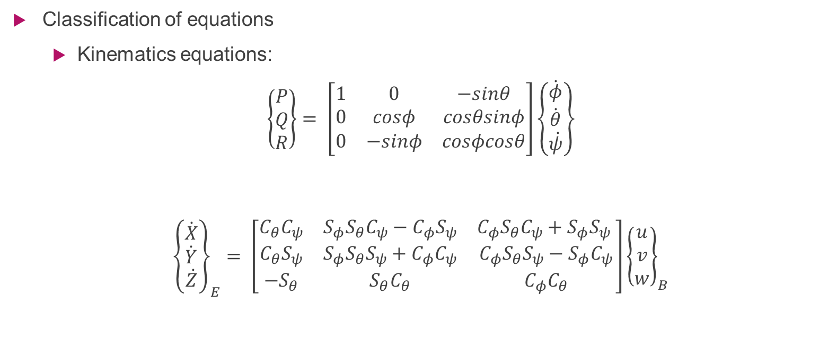
Flight Mechanics review
Classification of equations
Kinematics equations:
$$\left\{\begin{aligned}P \\ Q \\ R\end{aligned}\right\}= \left[\begin{matrix}1 & 0 & −sinθ \\ 0 & cosφ & cosθsinφ \\ 0 & −sinφ & cosφcosθ\end{matrix}\right]\left\{\dot{\begin{aligned}φ \\ \dot{\begin{aligned}θ \\ \dot{ψ}\end{aligned}}\end{aligned}}\right\}$$
$${\left\{\dot{\begin{aligned}X \\ \dot{\begin{aligned}Y \\ \dot{Z}\end{aligned}}\end{aligned}}\right\}}_{E}= \left[\begin{matrix}C_{θ}C_{ψ} & S_{φ}S_{θ}C_{ψ}−C_{φ}S_{ψ} & C_{φ}S_{θ}C_{ψ}+S_{φ}S_{ψ} \\ C_{θ}S_{ψ} & S_{φ}S_{θ}S_{ψ}+C_{φ}C_{ψ} & C_{φ}S_{θ}S_{ψ}−S_{φ}C_{ψ} \\ −S_{θ} & S_{θ}C_{θ} & C_{φ}C_{θ}\end{matrix}\right]{\left\{\begin{aligned}u \\ v \\ w\end{aligned}\right\}}_{B}$$

Slide 22
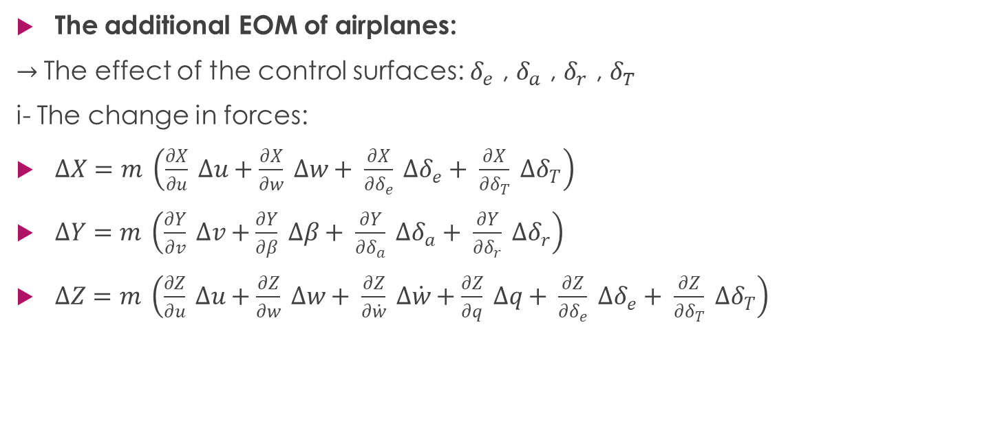
Flight Mechanics review
The additional EOM of airplanes:
$→$The effect of the control surfaces: $δ_{e}$ , $δ_{a}$ , $δ_{r}$ , $δ_{T}$
i- The change in forces:
$∆X=m \left(\frac{∂X}{∂u} ∆u+\frac{∂X}{∂w} ∆w+ \frac{∂X}{∂δ_{e}} ∆δ_{e}+ \frac{∂X}{∂δ_{T}} ∆δ_{T}\right)$
$∆Y=m \left(\frac{∂Y}{∂v} ∆v+\frac{∂Y}{∂β} ∆β+ \frac{∂Y}{∂δ_{a}} ∆δ_{a}+ \frac{∂Y}{∂δ_{r}} ∆δ_{r}\right)$
$∆Z=m \left(\frac{∂Z}{∂u} ∆u+\frac{∂Z}{∂w} ∆w+ \frac{∂Z}{∂\dot{w}} ∆\dot{w}+\frac{∂Z}{∂q} ∆q+ \frac{∂Z}{∂δ_{e}} ∆δ_{e}+ \frac{∂Z}{∂δ_{T}} ∆δ_{T}\right)$

Slide 23
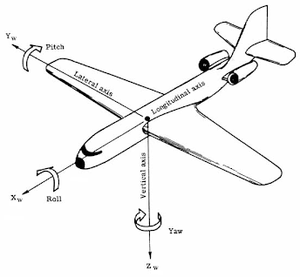
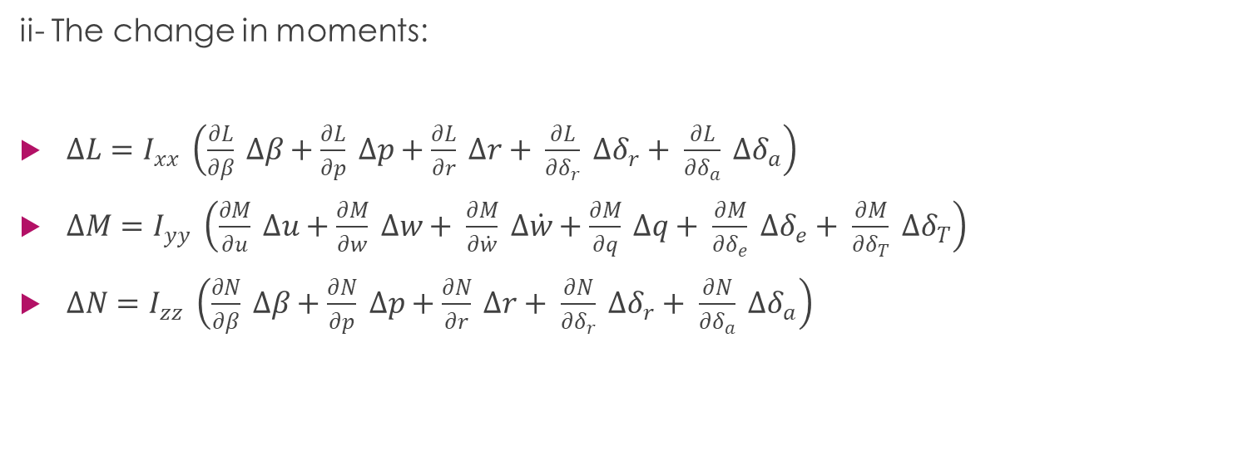
Flight Mechanics review
ii- The change in moments:
$∆L=I_{xx} \left(\frac{∂L}{∂β} ∆β+\frac{∂L}{∂p} ∆p+\frac{∂L}{∂r} ∆r+ \frac{∂L}{∂δ_{r}} ∆δ_{r}+ \frac{∂L}{∂δ_{a}} ∆δ_{a}\right)$
$∆M=I_{yy} \left(\frac{∂M}{∂u} ∆u+\frac{∂M}{∂w} ∆w+ \frac{∂M}{∂\dot{w}} ∆\dot{w}+\frac{∂M}{∂q} ∆q+ \frac{∂M}{∂δ_{e}} ∆δ_{e}+ \frac{∂M}{∂δ_{T}} ∆δ_{T}\right)$
$∆N=I_{zz} \left(\frac{∂N}{∂β} ∆β+\frac{∂N}{∂p} ∆p+\frac{∂N}{∂r} ∆r+ \frac{∂N}{∂δ_{r}} ∆δ_{r}+ \frac{∂N}{∂δ_{a}} ∆δ_{a}\right)$

Slide 24
Flight Mechanics review
The EOM’s are coupled, nonlinear and first order DE.
Difference bet. Body & inertial Axes
Body axes: they are a set of axes which are fixed at the body in its translational and rotations.
Inertial axes: they are a set of axes which are fixed at a specified position on the ground.

Slide 25
Flight Mechanics review
Pitch angle: it’s the angle between the body y-axis and the horizon.
AOA: the angle at which the chord of an aircraft's wing meets the relative wind.
Sideslip angle: it’s formed due to lateral deviation between the plane and the direction of the flow.
Yaw angle (heading): it’s formed due to the rotation about z-axis.

Slide 26
numerical solving algorithms for ODE
One-step methods, like:
Multistep methods, like:
Other methods
Euler-Cauchy method
Improved Euler method
Raunge-Kutta method
Backward Euler method
Adams-Bash forth method
Adams-Moulton method
Predector –coeector methods
Exponential integrator methods

Slide 27
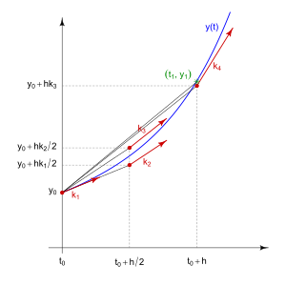
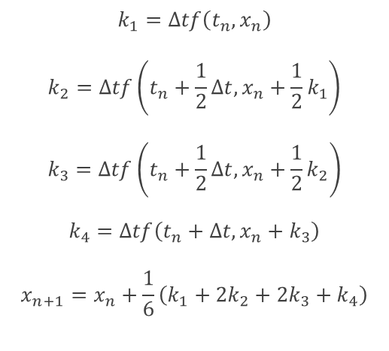
The chosen method for solving the aircraft EOM
4th order Runge-Kutta
We choose to use Raunge-Kutta method since its one of the most accurate one step methods used in the numerical solutions, in addition it’s the method used in the MATLAB ODE45 algorithm.
$$k_{1}=Δtf\left(t_{n},x_{n}\right)$$
$$k_{2}=Δtf\left(t_{n}+\frac{1}{2}Δt,x_{n}+\frac{1}{2}k_{1}\right)$$
$$k_{3}=Δtf\left(t_{n}+\frac{1}{2}Δt,x_{n}+\frac{1}{2}k_{2}\right)$$
$$k_{4}=Δtf\left(t_{n}+Δt,x_{n}+k_{3}\right)$$
$$x_{n+1}=x_{n}+\frac{1}{6}\left(k_{1}+2k_{2}+2k_{3}+k_{4}\right)$$

Slide 28
Numerical Solver for the RBD Equations
Task 2

Slide 29
Inputs
Initial Conditions
$$\left[u_{0} v_{0} w_{0}, p_{0} q_{0} r_{0}, φ_{0} θ_{0} ψ_{0}, x_{0} y_{0} z_{0}\right]$$
[𝒖_𝟎 𝒗_𝟎 𝒘_𝟎, 𝒑_𝟎 𝒒_𝟎 𝒓_𝟎, 𝝓_𝟎 𝜽_𝟎 𝝍_𝟎, 𝒙_𝟎 𝒚_𝟎 𝒛_𝟎 ]
Mass & Inertia
Forces
Moments
$$I= \left[\begin{matrix}I_{x} & I_{xy} & I_{xz} \\ I_{yx} & I_{y} & I_{yz} \\ I_{zx} & I_{zy} & I_{z}\end{matrix}\right]=\left[\begin{matrix}1 & −2 & −1 \\ −2 & 5 & −3 \\ −1 & −3 & 0.\end{matrix}\right]$$
𝑰= [■8(𝑰_𝒙&𝑰_𝒙𝒚&𝑰_𝒙𝒛@𝑰_𝒚𝒙&𝑰_𝒚&𝑰_𝒚𝒛@𝑰_𝒛𝒙&𝑰_𝒛𝒚&𝑰_𝒛 )]=[■8(1&−2&−1@−2&5&−3@−1&−3&0.)]
Mass = 15 kg
F = [10 5 9]
M = [10 20 5]

Slide 30
System of Equations
Kinetics Equations
Kinematics Equations
$$\left\{\dot{\begin{aligned}φ \\ \dot{\begin{aligned}θ \\ \dot{ψ}\end{aligned}}\end{aligned}}\right\}= \left[\begin{matrix}1 \\ 0 \\ 0\end{matrix} \begin{matrix}Sφ Tθ \\ Cφ \\ {Sφ}/{Cθ}\end{matrix} \begin{matrix}Cφ Tθ \\ −Sφ \\ {Cφ}/{Cθ}\end{matrix}\right]\left\{\begin{aligned}P \\ Q \\ R\end{aligned}\right\}$$
{(█(𝜙@(█(𝜃@𝜓 ̇ )) ̇ )) ̇ }= [■8(1@0@0) ■8(𝑆𝜑 𝑇𝜃@𝐶𝜑@𝑆𝜑⁄𝐶𝜃) ■8(𝐶𝜑 𝑇𝜃@−𝑆𝜑@𝐶𝜑⁄𝐶𝜃)]{█(𝑃@𝑄@𝑅)}
$$F_{x}=m(\dot{u}+qw−rv)$$
𝐹_𝑥=𝑚(𝑢 ̇+𝑞𝑤−𝑟𝑣)
$$F_{y}=m(\dot{v}+ru−pw)$$
𝐹_𝑦=𝑚(𝑣 ̇+𝑟𝑢−𝑝𝑤)
$$F_{z}=m\left(\dot{w}+pv−qu\right)$$
𝐹_𝑧=𝑚(𝑤 ̇+𝑝𝑣−𝑞𝑢)
$$L= \dot{H_{x}}+{qH}_{z}−rH_{y}$$
𝐿= (𝐻_𝑥 ) ̇+〖𝑞𝐻〗_𝑧−𝑟𝐻_𝑦
$$M= \dot{H_{y}}+{rH}_{x}−pH_{z}$$
𝑀= (𝐻_𝑦 ) ̇+〖𝑟𝐻〗_𝑥−𝑝𝐻_𝑧
$$N=\dot{H_{z}}+pH_{y}−qH_{x}$$
𝑁=(𝐻_𝑧 ) ̇+𝑝𝐻_𝑦−𝑞𝐻_𝑥
$$\left\{\dot{\begin{aligned}X \\ \dot{\begin{aligned}Y \\ \dot{Z}\end{aligned}}\end{aligned}}\right\}= \left[\begin{matrix}C_{θ}C_{ψ} & S_{φ}S_{θ}C_{ψ}−C_{φ}S_{ψ} & C_{φ}S_{θ}C_{ψ}+S_{φ}S_{ψ} \\ C_{θ}S_{ψ} & S_{φ}S_{θ}S_{ψ}+C_{φ}C_{ψ} & C_{φ}S_{θ}S_{ψ}−S_{φ}C_{ψ} \\ −S_{θ} & S_{θ}C_{θ} & C_{φ}C_{θ}\end{matrix}\right]\left\{\begin{aligned}u \\ v \\ w\end{aligned}\right\}$$
{(█(𝑋@(█(𝑌@𝑍 ̇ )) ̇ )) ̇ }= [■8(𝐶_𝜃 𝐶_𝜓&𝑆_𝜙 𝑆_𝜃 𝐶_𝜓−𝐶_𝜙 𝑆_𝜓&𝐶_𝜙 𝑆_𝜃 𝐶_𝜓+𝑆_𝜙 𝑆_𝜓 @𝐶_𝜃 𝑆_𝜓&𝑆_𝜙 𝑆_𝜃 𝑆_𝜓+𝐶_𝜙 𝐶_𝜓&𝐶_𝜙 𝑆_𝜃 𝑆_𝜓−𝑆_𝜙 𝐶_𝜓@−𝑆_𝜃&𝑆_𝜃 𝐶_𝜃&𝐶_𝜙 𝐶_𝜃 )]{█(𝑢@𝑣@𝑤)}

Slide 31
Outputs
States
$$\left[u v w, p q r, φ θ ψ, x y z\right]$$
[𝒖 𝒗 𝒘, 𝒑 𝒒 𝒓, 𝝓 𝜽 𝝍, 𝒙 𝒚 𝒛]
(states values over the specified time span )

Slide 32
Code Strategy
6DOF
Initial Conditions
Forces
RBD Solver
Moments
Inertia & Mass
Solving
Solving state by state using RBD Solver
Appling RK4 in order to evaluate the next state.
Evaluation of 12 equation for given set of inputs
Verifying
Using Simulink (equations)
Using ode45 (integration)

Slide 33
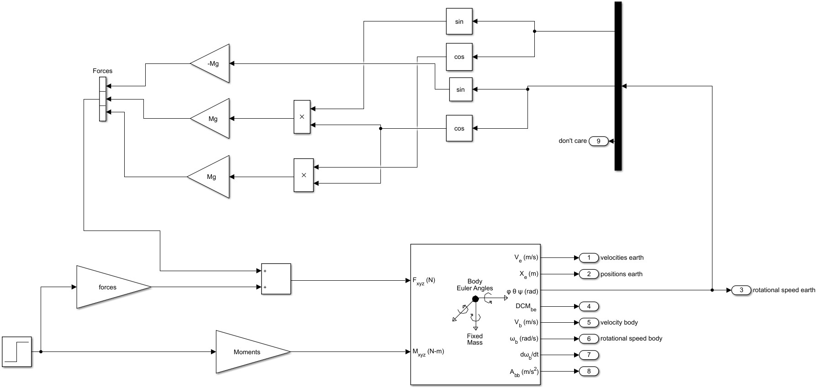
Simulink

Slide 34
Results & Verifying

Slide 35
Results & Verifying

Slide 36
Results & Verifying

Slide 37
Results & Verifying

Slide 38
Airplane Simulator Part II
Task 3

Slide 39
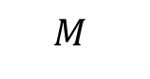
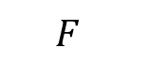
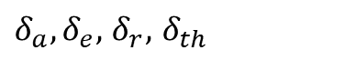
Nonlinear model
Gravity forces
Airframe
RBD
$δ_{a},δ_{e},$ $δ_{r},$ $δ_{th}$
$$F$$
States
$$M$$

Slide 40
Forces Acting on A\C
Thrust
Aerodynamic forces
Gravity force

Slide 41
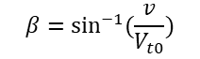






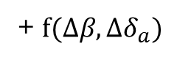
Airframe equations
$$β=\sin^{−1}{(\frac{v}{V_{t0}})}$$
$ΔX=F(Δu,Δw,{Δδ}_{e},{Δδ}_{thrust}$)
$ΔL=F(Δv,Δp,Δr,{Δδ}_{r},{Δδ}_{a}$)
$ΔY=F(Δv,Δp,Δr,{Δδ}_{r}$)
$ΔM=F(Δu,Δw,\dot{Δw},Δq,Δδ_{e},{Δδ}_{thrust}$)
+ $f(Δβ,Δδ_{a})$
$ΔZ=F(Δu,Δw,Δ\dot{w},Δq,{Δδ}_{e},Δδ_{thrust}$)
$ΔN=F(Δv,Δp,Δr,{Δδ}_{r},{Δδ}_{a}$)
$$β=\sin^{−1}{(\frac{v}{V_{t0}})}$$

Slide 42
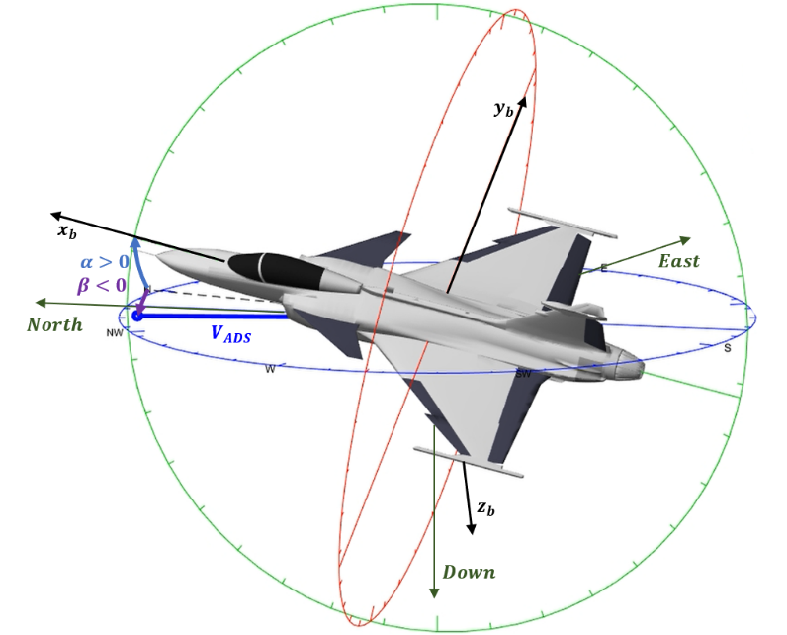
The conditions on body axis
The center of the axis coincide on the CG of the body.
X-Z plane is the plan of symmetry.

Slide 43
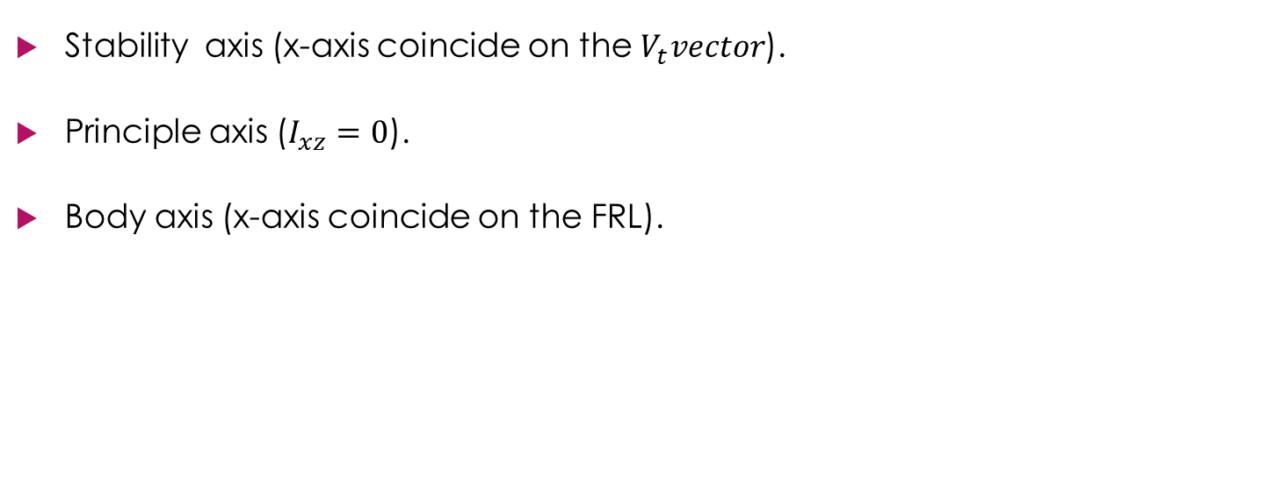
Types of body axis
Stability axis (x-axis coincide on the $V_{t}vector$).
Principle axis ($I_{xz}=0$).
Body axis (x-axis coincide on the FRL).

Slide 44
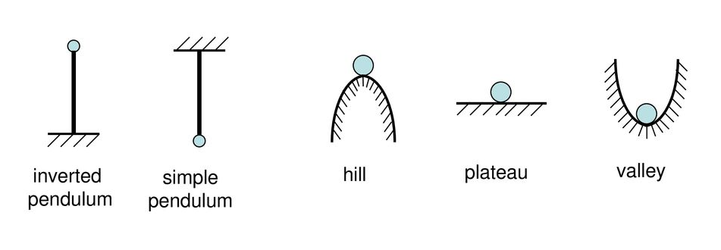
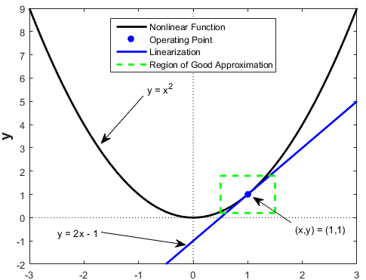
Consequences of the linearization
For the linearization to be valid with an acceptable error the perturbations must be small.
Hance we usually choose one of the equilibrium points to linearize the equations around it; Using the steady state values at the given operating condition as a reference.

Slide 45
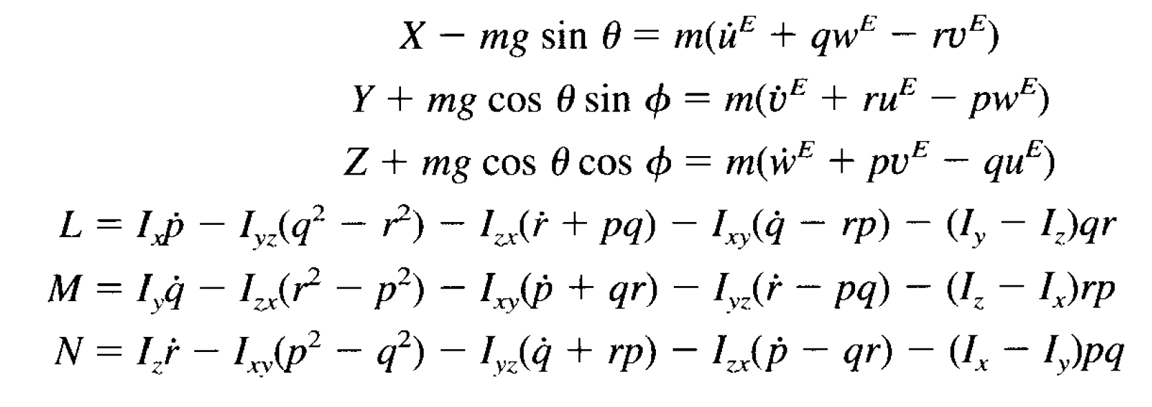
steady level flight
there is no moments acting on the aircraft.
The forces acting on the aircraft must be in equilibrium.
The rate of change of states is zero.
Forces and moments in the body axis

Slide 46
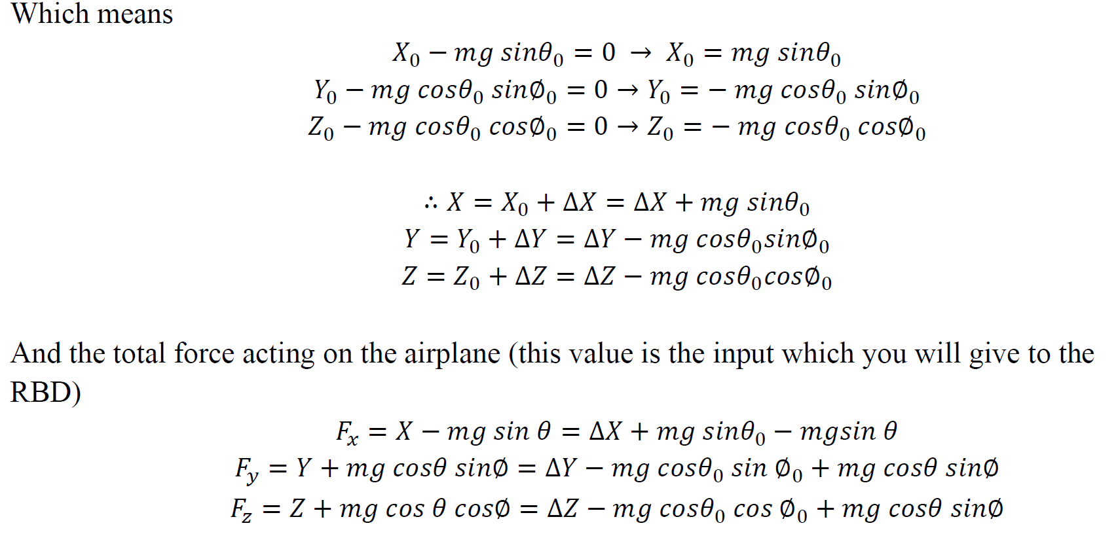
steady level flight
And the total force acting on the airplane Equals the vectorial sum of the aerodynamic and gravity forces.
Where$X,Y,Z$express the aerodynamic forces.

Slide 47
Airplane Equations of Motion Linearization
Task 4

Slide 48
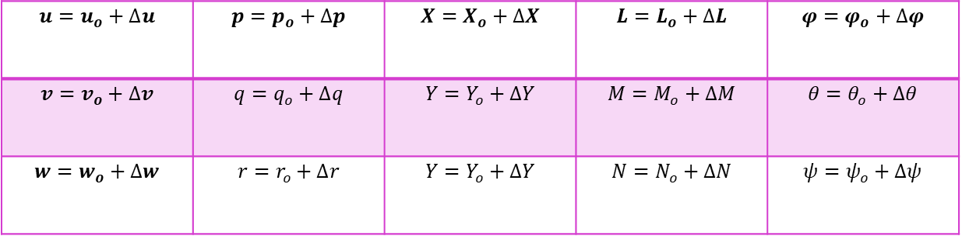
Linearization
By using small perturbation theory we can linearize EOM’s of the airplane
$$u=u_{o}+∆u$$ | $$p=p_{o}+∆p$$ | $$X=X_{o}+∆X$$ | $$L=L_{o}+∆L$$ | $$φ=φ_{o}+∆φ$$
$$v=v_{o}+∆v$$ | $$q=q_{o}+∆q$$ | $$Y=Y_{o}+∆Y$$ | $$M=M_{o}+∆M$$ | $$θ=θ_{o}+∆θ$$
$$w=w_{o}+∆w$$ | $$r=r_{o}+∆r$$ | $$Y=Y_{o}+∆Y$$ | $$N=N_{o}+∆N$$ | $$ψ=ψ_{o}+∆ψ$$

Slide 49
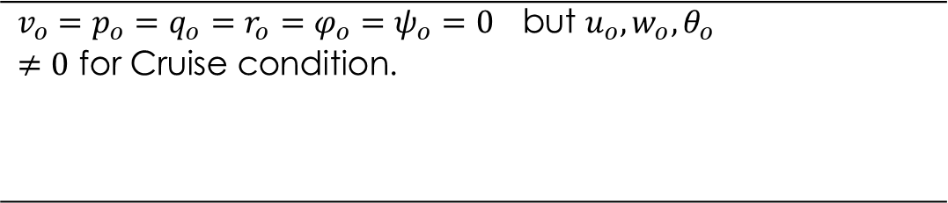
Reference Flight condition
$$v_{o}=p_{o}=q_{o}=r_{o}=φ_{o}=ψ_{o}=0 \text{but} u_{o},w_{o},θ_{o}≠0 \text{for} \text{Cruise} \text{condition}\text{.}$$

Slide 50
Linearization Technique
Step 1
step4
step3
Recast each variable in terms of a steady-state value and a perturbed value.
step2
Apply the small-angle assumption to trig functions of perturbed angle
Assume products of small perturbations are negligible.
Remove the steady-state equation from the perturbed equation.

Slide 51
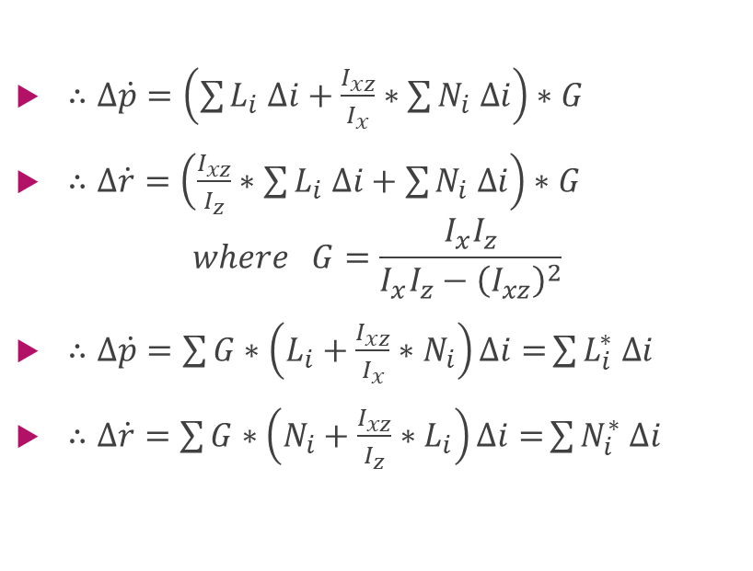
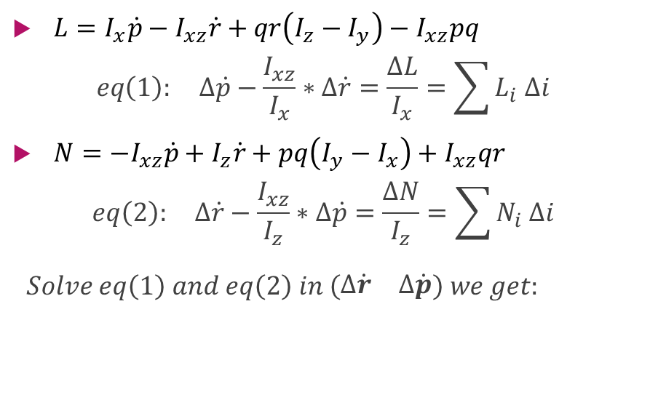
Notes in Lateral calculations
$L=I_{x}\dot{p}−I_{xz}\dot{r}+qr\left(I_{z}−I_{y}\right)−I_{xz}pq$
$$eq\left(1\right): ∆\dot{p}−\frac{I_{xz}}{I_{x}}∗∆\dot{r}=\frac{∆L}{I_{x}}=\sum{L_{i} ∆i}$$
$N={−I}_{xz}\dot{p}+I_{z}\dot{r}+pq\left(I_{y}−I_{x}\right)+I_{xz}qr$
$$eq\left(2\right): ∆\dot{r}−\frac{I_{xz}}{I_{z}}∗∆\dot{p}=\frac{∆N}{I_{z}}=\sum{N_{i} ∆i}$$
$$Solve eq\left(1\right) and eq\left(2\right) in \left(\begin{matrix}∆\dot{r} & ∆\dot{p}\end{matrix}\right) we get:$$
$∴∆\dot{p}=\left(\sum{L_{i} ∆i}+\frac{I_{xz}}{I_{x}}∗\sum{N_{i} ∆i}\right)∗G$
$∴∆\dot{r}=\left(\frac{I_{xz}}{I_{z}}∗\sum{L_{i} ∆i}+\sum{N_{i} ∆i}\right)∗G$
$$where G=\frac{I_{x}I_{z}}{I_{x}I_{z}−{\left(I_{xz}\right)}^{2}}$$
$∴∆\dot{p}=\sum{G∗\left(L_{i}+\frac{I_{xz}}{I_{x}}∗N_{i}\right)∆i=}\sum{L_{i}^{∗} ∆i}$
$∴∆\dot{r}=\sum{G∗\left(N_{i}+\frac{I_{xz}}{I_{z}}∗L_{i}\right)∆i=}\sum{N_{i}^{∗} ∆i}$

Slide 53
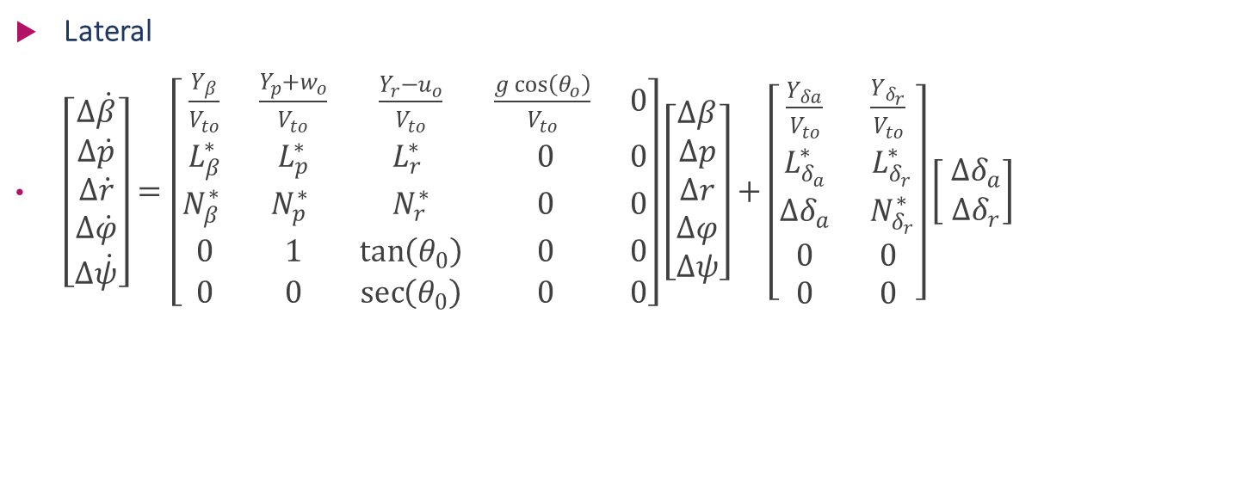
State space Model:
Lateral
$\left[\begin{aligned}Δ\dot{β} \\ Δ\dot{p} \\ Δ\dot{r} \\ Δ\dot{φ} \\ Δ\dot{ψ}\end{aligned}\right]=\left[\begin{matrix}\frac{Y_{β}}{V_{to}} & \frac{Y_{p}+w_{o}}{V_{to}} & \frac{Y_{r}−u_{o}}{V_{to}} & \frac{g\cos\left(θ_{o}\right)}{V_{to}} & 0 \\ L_{β}^{∗} & L_{p}^{∗} & L_{r}^{∗} & 0 & 0 \\ N_{β}^{∗} & N_{p}^{∗} & N_{r}^{∗} & 0 & 0 \\ 0 & 1 & \tan\left(θ_{0}\right) & 0 & 0 \\ 0 & 0 & \sec\left(θ_{0}\right) & 0 & 0\end{matrix}\right]\left[\begin{aligned}Δβ \\ Δp \\ Δr \\ Δφ \\ Δψ\end{aligned}\right]+\left[\begin{matrix}\frac{Y_{δa}}{V_{to}} & \frac{Y_{δ_{r}}}{V_{to}} \\ L_{δ_{a}}^{∗} & L_{δ_{r}}^{∗} \\ ∆δ_{a} & N_{δ_{r}}^{∗} \\ 0 & 0 \\ 0 & 0\end{matrix}\right]\left[\begin{aligned} ∆δ_{a} \\ ∆δ_{r}\end{aligned}\right]$

Slide 54
short period & Long period approximations of the Longitudinal dynamics
By solving the A matrix we get 2 pairs of conjugate roots the pair which has small real part has big settling time according to $T_{s}=\frac{4}{ζω_{n}}$ on the other hand with the pair which has bigger real part
By solving the A matrix we get 2 pairs of conjugate roots the pair which has small real part has big settling time according to 𝑇_𝑠=4/(𝜁𝜔_𝑛 ) on the other hand with the pair which has bigger real part

Slide 55
short period & Long period

Slide 56
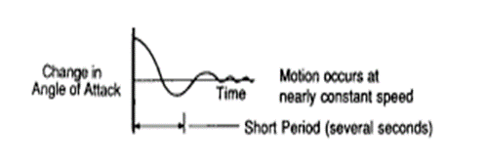
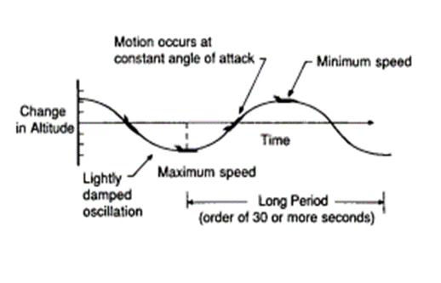
short period & Long period approximations of the Longitudinal dynamics
Short Period
Long period

Slide 57
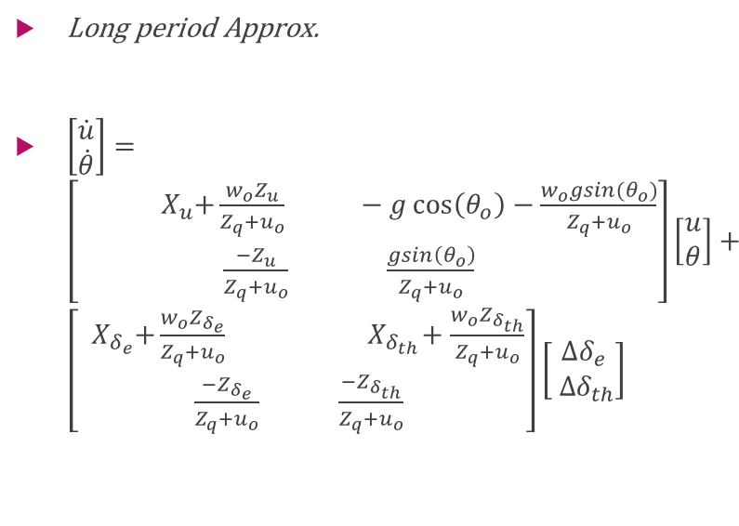
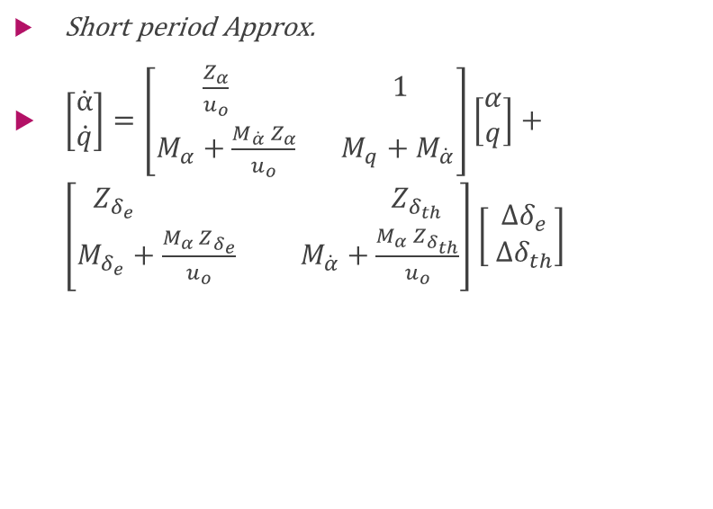
short period & Long period approximations of the Longitudinal dynamics
Short period Approx.
$\left[\begin{aligned}\dot{α} \\ \dot{q}\end{aligned}\right]=\left[\begin{aligned}\frac{Z_{α}}{u_{o}} 1 \\ M_{α}+\frac{{M_{\dot{α}} Z}_{α}}{u_{o}} M_{q}+M_{\dot{α}}\end{aligned}\right]\left[\begin{aligned}α \\ q\end{aligned}\right]+\left[\begin{aligned}Z_{δ_{e}} Z_{δ_{th}} \\ M_{δ_{e}}+\frac{{M_{α} Z}_{δ_{e}}}{u_{o}} M_{\dot{α}}+\frac{{M_{α} Z}_{δ_{th}}}{u_{o}}\end{aligned}\right]\left[\begin{aligned} ∆δ_{e} \\ ∆δ_{th}\end{aligned}\right]$
Long period Approx.
$\left[\begin{aligned}\dot{u} \\ \dot{θ}\end{aligned}\right]=\left[\begin{aligned}\begin{aligned}{ X}_{u}+\frac{w_{o}Z_{u}}{Z_{q}+u_{o}} −g\cos\left(θ_{o}\right)−\frac{w_{o}gsin(θ_{o})}{Z_{q}+u_{o}}\end{aligned} \\ \frac{−Z_{u}}{Z_{q}+u_{o}} \frac{gsin\left(θ_{o}\right)}{Z_{q}+u_{o}} \end{aligned}\right]\left[\begin{aligned}u \\ θ\end{aligned}\right]+\left[\begin{aligned}{ X}_{δ_{e}}+\frac{w_{o}Z_{δ_{e}}}{Z_{q}+u_{o}} { X}_{δ_{th}}+\frac{w_{o}Z_{δ_{th}}}{Z_{q}+u_{o}} \\ \frac{−Z_{δ_{e}}}{Z_{q}+u_{o}} \frac{−Z_{δ_{th}}}{Z_{q}+u_{o}} \end{aligned}\right]\left[\begin{aligned}∆δ_{e} \\ ∆δ_{th}\end{aligned}\right]$

Slide 58
Results due to elevator input 5 degree

Slide 59
Results due to elevator input

Slide 60
Results due to Thrust input 10000

Slide 61
Results due to Thrust input 10000

Slide 62
Auto Pilot
Task 5

Slide 63
Team 4
B.N. | Sec | Name
37 | 2 | Mohammed Ahmed Hassan Ahmed
1 | 1 | Ibrahim Thabet Allam
39 | 2 | Mohammed Hatem Mohammed Saeed
41 | 2 | Mohamed Hassan Gad Ali
43 | 2 | Mohammed Abd El MawgoudGhoneam

Slide 64
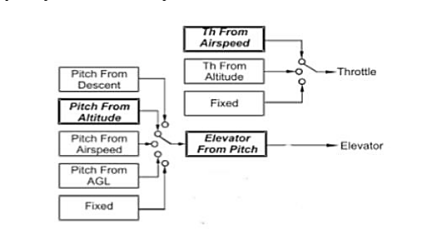
Introduction:
In order to Design a controller first of all we should get the transfer functions of all full longitudinal dynamics model.
Our methodology is to using inner loops architecture.
Then using SISO tool to design the controller.
Finally we use SIMULINK to check the performance of our design.

Slide 65
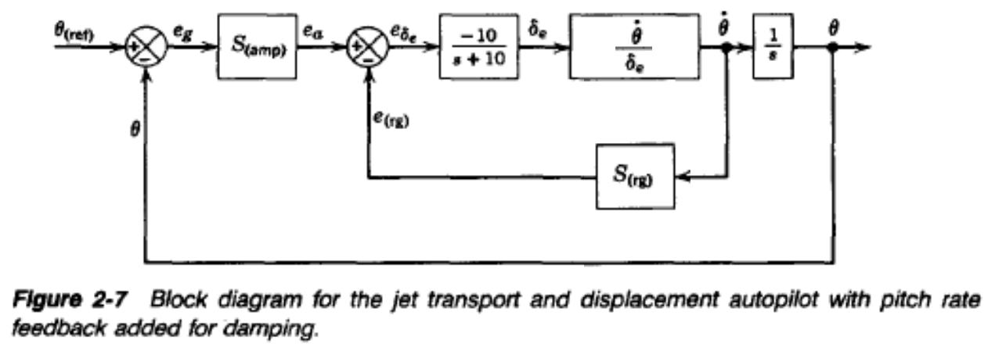
Design Pitch Controller With Pitch Rate Feedback
servo

Slide 66
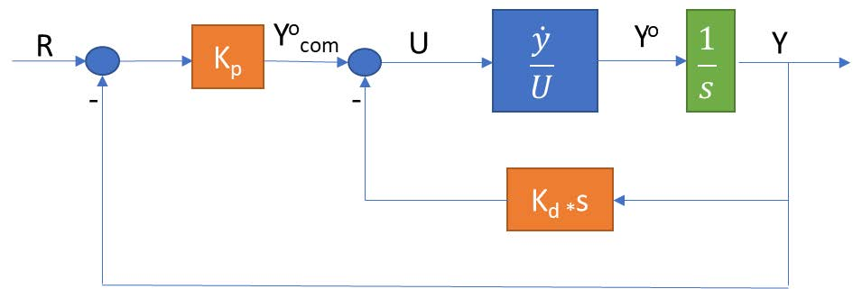
Design Pitch Controller With Pitch Rate Feedback

Slide 67
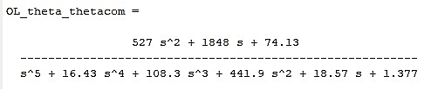
Design Pitch Controller With Pitch Rate Feedback
The open loop transfer function is:

Slide 68
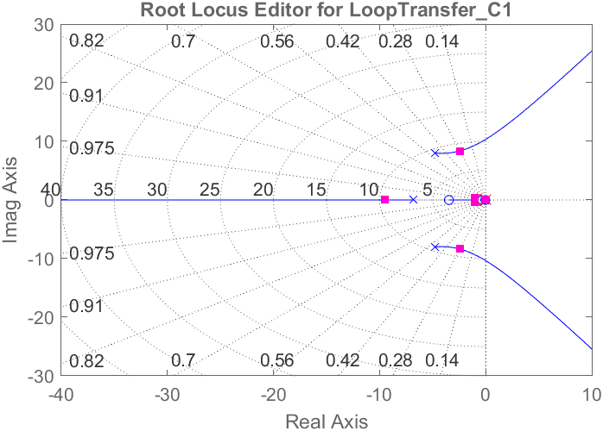
SISO Tool Design
Root locus

Slide 69
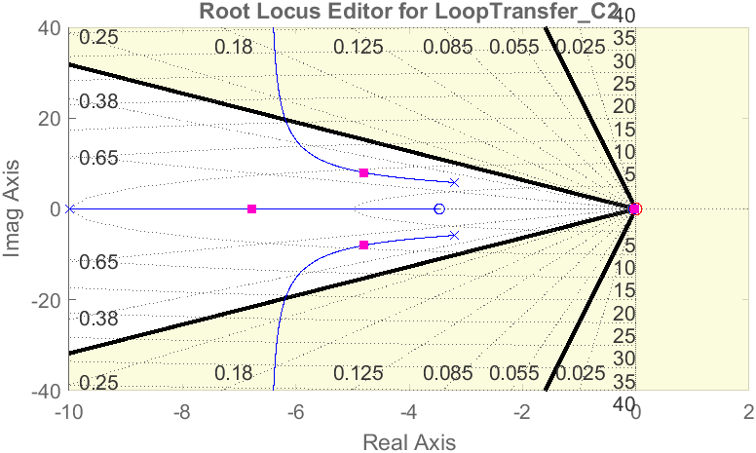
SISO Tool Design
Root locus

Slide 70
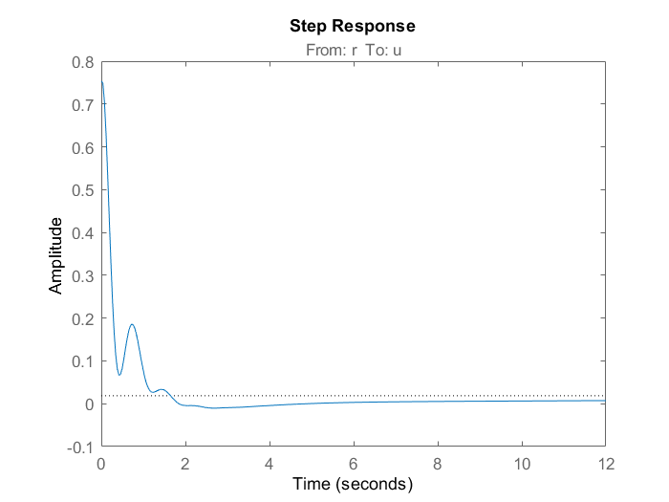

Step response
Control action
System Response

Slide 71
Simulink test

Slide 72

Simulink test

Slide 73

Necessity of velocity control

Slide 74
Necessity of velocity control
when we input positive pitch angle, the action depends on the thrust if the thrust is big enough to climb upward the airplane will climb upward if the thrust is not enough the airplane would dive downward but logically, when the pilot input a positive pitch the airplane should climb upward

Slide 75


Necessity of velocity control

Slide 76
Necessity of velocity control
Our plane climbs upward because it has enough thrust to accomplish this. But this not meaning that we control altitude because the airplane will climb to specific height that its thrust enough to reach, then the airplane would dive downward. And this specific height may be before or after that height we need to reach, so we need to control the velocity to reach to required altitude by change thrust ($δ_{th}$)

Slide 77

NT-33A engine
Our aircraft ‘NT-33A’ was a training aircraft that was developed from the Lockheed martin.
The Powerplant installed is 1 × Allison J33-A-35 centrifugal flow turbojet engine, with 5,400 lbf (24 kN) thrust for take-off with water injection
4,600 lbf (20,461.82 N) maximum continuous thrust.

Slide 78

Velocity Controller

Slide 79


Velocity Controller

Slide 80


Velocity Controller

Slide 81
Step response & Control action
Step response
Control action

Slide 82

Altitude controller

Slide 83

Altitude controller

Slide 84


Altitude Controller

Slide 85
Step response & Control action
Step response
Control action

Slide 86

simulation
Results

Slide 87

Simulation Blocks

Slide 88

Simulation Blocks

Slide 89
Simulink Results of 1000ft Command

Slide 90
Simulink Results of 1000ft Command

Slide 91
Simulink Results of 1000ft Command

Slide 92
Auto Pilot
Task 6

Slide 93

Lateral Control
The rule of the lateral autopilot is to control the motion of the airplane in the lateral-directional plane, it controls the rudder & aileron to achieve a coordinated turn
What is coordinated turn ??

Slide 94



coordinated turn We may call it “zero-lateral acceleration turn”
In terms of mechanics
Normal flight
Medium banked turn
Steep banked turn

Slide 95
coordinated turn
In terms of aerodynamics
When lift increases in one of the wings the drag also increases
On that wing resulting in “adverse yaw phenomenon”
To overcome this phenomenon we need rudder input

Slide 96
coordinated turn
In terms of aerodynamics
The coordinated turn is a maneuver in which the airplane’s heading angle is changed (airplane turns) without “slipping or skidding”, i.e. the side slip angle (β = 0). note: skidding is having +ve sideslip angle (β>0) while slipping is having -ve sideslip angel (β<0)

Slide 97

“Yaw damper” for the Dutch roll mode
Design

Slide 98

“Yaw damper” for the Dutch roll mode
Design

Slide 101

Test The “Yaw damper” controllers on the full state space model

Slide 102

Simulink Test

Slide 103
Test Result

Slide 104

Roll Controller

Slide 105
Roll Controller
Design

Slide 106
Response

Slide 107
Control Action

Slide 108

Coordination

Slide 109

Lateral controller Test with Simulink

Slide 110
Result

Slide 111
Autopilot
Task 7

Slide 112
Autopilot Testing on Non-Linear Simulation
Lateral Autopilot
Longitudinal
Autopilot
Autopilot Controller

Slide 113


Autopilot Testing on Non-Linear Simulation
This task is depending on the comparison between lineal and non-linear simulators for the two portions of autopilot controller.
The comparison is mainly depending on the changes in the control surfaces: $δ_{a}, δ_{r}$, $δ_{e}$, $δ_{Th}$

Slide 114

Develop the testing loop containing the “Controller + Simulator”

Slide 115

Develop the testing loop containing the “Controller + Simulator”

Slide 116

Comparison bet. Linear & Nonlinear simulator in pitch controller

Slide 117
Test the “Pitch controller” for $33.5°$
1- u

Slide 118

Test the “Pitch controller” for $33.5°$
2- $γ$

Slide 119

Test the “Pitch controller” for $33.5°$
3-$θ$

Slide 120

Test the “Pitch controller” for $33.5°$
4- $δ_{elevator}$

Slide 121
Test the “Pitch controller” for $33.5°$
5- h

Slide 122
Test the “Pitch controller + Velocity controller” for 15$°$
1- u

Slide 123
Test the “Pitch controller + Velocity controller” for 15$°$
2- Theta

Slide 124
Test the “Pitch controller + Velocity controller” for 15$°$
3- h

Slide 125

Test the “Pitch controller + Velocity controller” for 15$°$
4- $γ$

Slide 126

Test the “Pitch controller + Velocity controller” for 15$°$
5- $D_{Th}$

Slide 127

Test the “Pitch controller + Velocity controller” for 15$°$
6- $δ_{elevator}$

Slide 128

Test the “Altitude Hold” of 1000 ft
1- $θ$

Slide 129
Test the “Altitude Hold” of 1000 ft
2- u

Slide 130

Test the “Altitude Hold” of 1000 ft
3- $γ$

Slide 131
Test the “Altitude Hold” of 1000 ft
4- h

Slide 132

Test the “Altitude Hold” of 1000 ft
5- $δ_{elevator}$

Slide 133

Test the “Altitude Hold” of 1000 ft
6- $δ_{Thrust}$

Slide 134
Test the “Lateral controller” and compare the response with the same test on the State space model

Slide 135
Test the “Lateral controller” and compare the response with the same test on the State space model

Slide 136
Test the “Lateral controller” and compare the response with the same test on the State space model

Slide 137
Test the “Lateral controller” and compare the response with the same test on the State space model

Slide 138
Test the “Lateral controller” and compare the response with the same test on the State space model

Slide 139
Test the “Lateral controller + Altitude Hold controller” and compare the response with the same test on the State space model

Slide 140
Test the “Lateral controller + Altitude Hold controller” and compare the response with the same test on the State space model

Slide 141
Test the “Lateral controller + Altitude Hold controller” and compare the response with the same test on the State space model

Slide 142
Test the “Lateral controller + Altitude Hold controller” and compare the response with the same test on the State space model

Slide 143
Test the “Lateral controller + Altitude Hold controller” and compare the response with the same test on the State space model

Slide 144
Test the “Lateral controller + Altitude Hold controller” and compare the response with the same test on the State space model

Slide 145
Test the “Lateral controller + Altitude Hold controller” and compare the response with the same test on the State space model

Slide 146
Test the “Lateral controller + Altitude Hold controller” and compare the response with the same test on the State space model

Slide 147

Perform a complete autonomous mission including “climb, cruise, turn, descent”
6- $3d_track$

Slide 148

Perform a complete autonomous mission including “climb, cruise, turn, descent”
6- $group$

Slide 149

Perform a complete autonomous mission including “climb, cruise, turn, descent”
6- $xy_track$

Slide 150

Perform a complete autonomous mission including “climb, cruise, turn, descent”
6- $xz_track$

Slide 151

Perform a complete autonomous mission including “climb, cruise, turn, descent”
6- $yz_track$

Slide 152
Thanks

